Slide 1
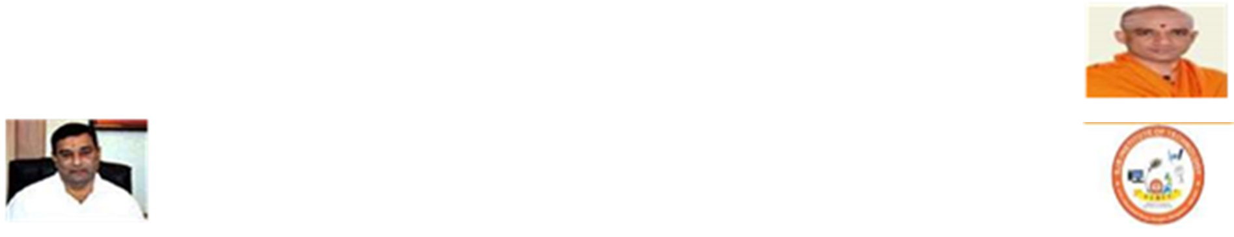


SJB Institute of Technology
Project Review II
on
“PERSONALIZED CREDIT SCORE”
Under The Guidance of
Dr. Srikantaiah K C
Professor
Department of CSE
Presented By
Shreyanshi [1JB13CS148]
Shriyanka B V [1JB13CS149]
Shubham Verma [1JB13CS152]
Sujeet Kumar [1JB13CS160]

Slide 2
OVERVIEW OF PREVIOUS PRESENTATION
INTRODUCTION :
What is credit score?
A number ranging from 300 to 850 which represents person’s credit worthiness.
How it is calculated?
It is calculated based on different types of transactions such as general usages, payment history(electricity bill,
water bill, insurance premium etc.) credit utilization etc.
LITERATURE SURVEY:
Credit Rating in India: A Study of Rating Methodology of Rating Agencies , 2011.
The impact of credit scoring on consumer lending, 2013.
A study of awareness about CIBIL and credit information reports among customers at commercial banks, 2014.
Research and application of credit score based on decision tree algorithm, 2011.
PROBLEM STATEMENT:
Low awareness
Online contractual payments
Social influence

Slide 3
OVERVIEW OF PREVIOUS PRESENTATION(contd..)
PROPOSED SYSTEM AND EXISTING SYSTEM:
The similarities and differences between proposed and existing system
REQUIREMENT ANALYSIS:
Hardware and Software requirements
Functional and non-functional requirements
SYSTEM DESIGN:
The system architecture and its components along with its functionality.

Slide 4
SYSTEM ARCHITECTURE

Slide 5


USE CASE DIAGRAM
Application Server
Login/Logout
Checking Live Scores
UID Authentication Server
Benefits
USER
AADHAR Verification
PAN Verification
PAN Authentication Server

Slide 6
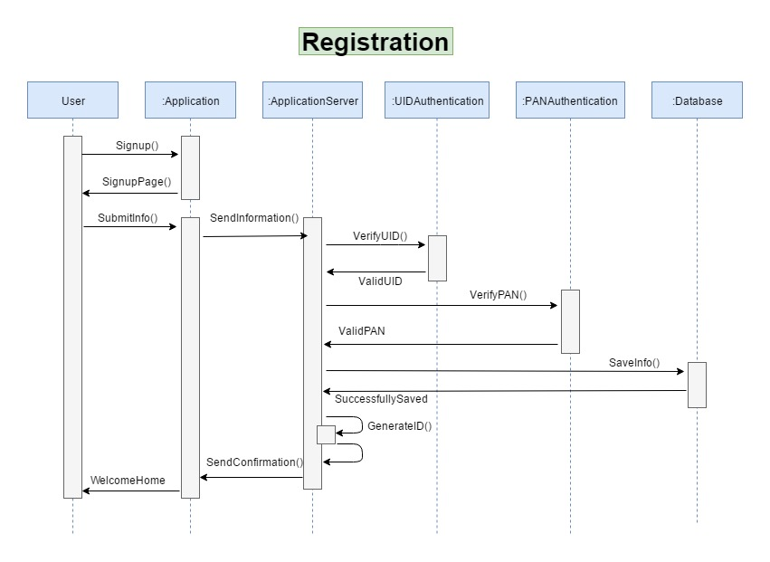
SEQUENCE DIAGRAM

Slide 7
IMPLEMENTATION
UID VERFICATION MODULE (UVM)
Sends the user UID to UID Authentication server to check if it’s valid
FACE DETECTION MODULE (FDM)
detects user’s face and unlocks the application
APPLICATION SERVER MODULE (ASM)
Calculates live score of the user
Links to UVM for aadhar verification
Links to PVM for PAN verification
Stores user details to Database
Links to OVM for OTP generation
Links to FDM for identifying the user.
USER MODULE
Registers himself/herself to AS module
Logs into account using AS module
Checks live score
OTP VERFICATION MODULE (OVM)
Sends OTP to user’s mobile for security
PAN VERFICATION MODULE (PVM)
Sends the user PAN to PAN Authentication server to check if it’s valid
OTHERS
Settings
Prediction

Slide 8
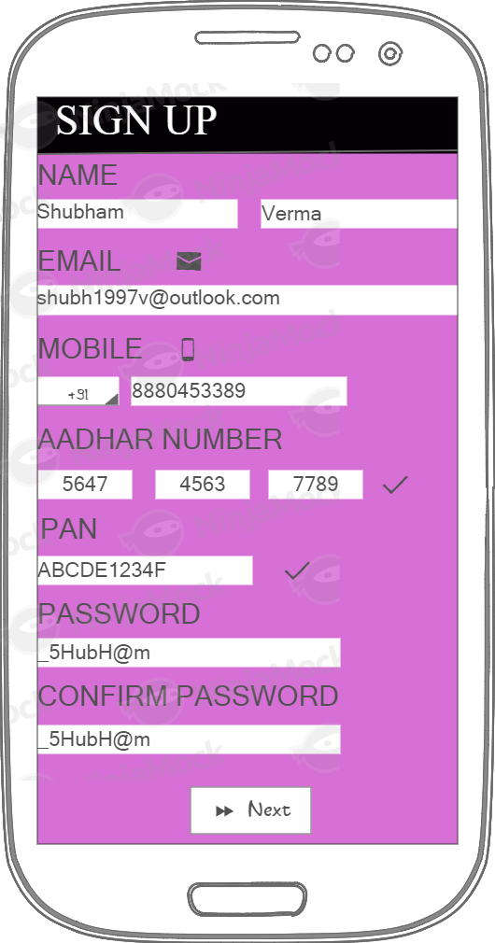
WORK DONE SO FAR(contd..)
SIGNUP PAGE
GET Username
GET Email
GET Mobile_no
GET UID_no
GET PAN_no
IF (PAN==True && UID==True)
THEN
Login Successful
ELSE
User already exist.
ENDIF

Slide 9
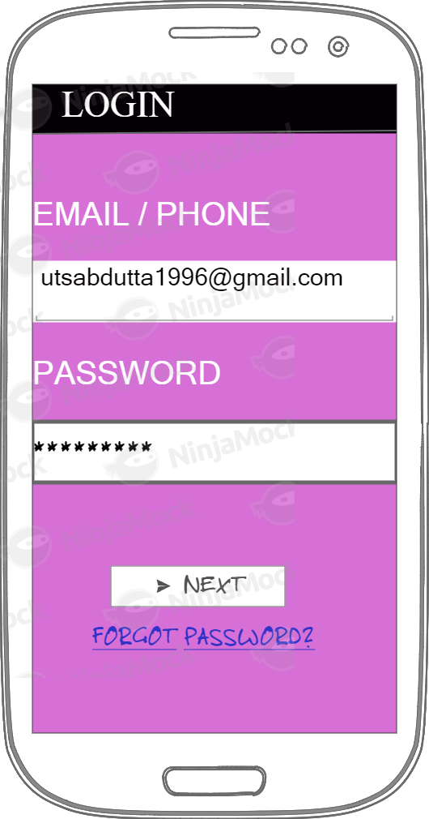
WORK DONE SO FAR
LOGIN PAGE
GET Username
GET Password
IF (Username == EnteredUsername && Password == EnteredPassword) THEN
Login Successful
ELSE
Login Failed.
ENDIF
abc@gmail.com

Slide 10
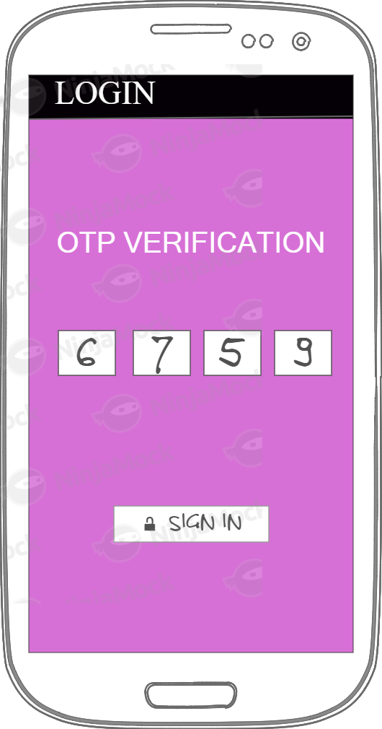
WORK DONE SO FAR(contd..)
OTP Page
1.Generator code
Required parameters:
recipient (string) - phone number in international format.
sender (string) - name of the sender (min 3, max 11)
Optional:
length - length of the code (min 4, max 10, int) (default = 5)
expiry - expiry in seconds (min 10, max 3600, int) (default = 60s)
allow Push (boolean) - Allow code to be send via push notification.
2.Verify code
Required parameters:
id - code identifier (string)
code - the code (string)

Slide 11
PLAN OF ACTION
LITERATURE SURVEY
(26-FEB-2017)
SYNOPSIS
(2-FEB-2017)
REQUIREMENT ANALYSIS
(4-MAR-2017)
DESIGN
(20-MAR-2017)
IMPLEMENTATION
(25-APR-2017)
TESTING
(12-MAY-2017)

Slide 12
CONCLUSION
PERSONALISED CREDIT SCORE Application provides –
Live scores
Security features
Verifies AADHAR card number
Verifies PAN of the user during signup
Sends OTP during every login of the user

Slide 13
REFERENCES
[1] J. Simon and P.J. Simon, Head First Android development. Sudbury, MA, UnitedStates: O’Reilly Media, Inc , USA, 2011.
[2] Jackson, W. (2013). Learn Android app development. Berkeley, CA: SPRINGER A PR TRADE.
[3] Sierra, K., Bates, B. (2005). Head first java: [your brain on java – a learner’s guide] (2nd ed.). Boston, MA, United States: O’Reilly Media, Inc, USA.
[4] K. Jamsa, Introduction to web development using Html 5. Sudbury, MA, UnitedStates: Jones and Bartlett Publishers, 2013.
[5] R. Chopra, Database management system (DBMS): A practical approach: Concepts, principals, case studies, experiments. New Delhi: S Chand & Co, 2010

